Slide 1
Contents
Theoretical Basis for Data Communications
Guided Transmission Media
Wireless Transmission
Digital Modulation and Multiplexing

Slide 2
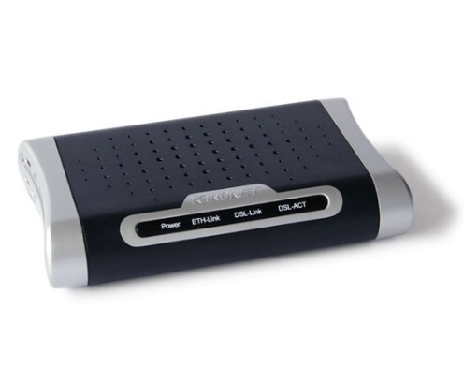
Foundation on which other layers build
Properties of wires, fiber, wireless limit what the network can do
Key problem is to send (digital) bits using only (analog) signals
This is called modulation
Application
Transport
Network
Link
Modem
Physical

Slide 3
We’ll start with an abstraction of a physical channel
Rate (or bandwidth, capacity, speed) in bits/second
Delay in seconds, related to length
Other important properties:
Whether the channel is broadcast, and its error rate
Message
Delay D
Rate R

Slide 4

Latency is the delay to send a message over a link
– Transmission delay: time to put M-bit message “on the wire”
T-delay = M (bits) / Rate (bits/sec) = M/R seconds
– Propagation delay: time for bits to propagate across the wire
P-delay = Length / speed of signals = Length / ⅔c = D seconds
– Combining the two terms we have:

Slide 5
The main prefixes we use:
• Use powers of 10 for rates, 2 for storage
1 Mbps = 1,000,000 bps, 1 KB = 2¹⁰ bytes
• “B” is for bytes, “b” is for bits
Prefix | Exp. | Prefix | Exp.
K(ilo) | 10³ | m(illi) | 10⁻³
M(ega) | 10⁶ | μ(micro) | 10⁻⁶
G(iga) | 10⁹ | n(ano) | 10⁻⁹
Notes:
Deca, hector,Tera, Peta, Exa, Zetta, Yotta
Decimal
Deci, centi, pico, femto, atto, zepto, yocto

Slide 6
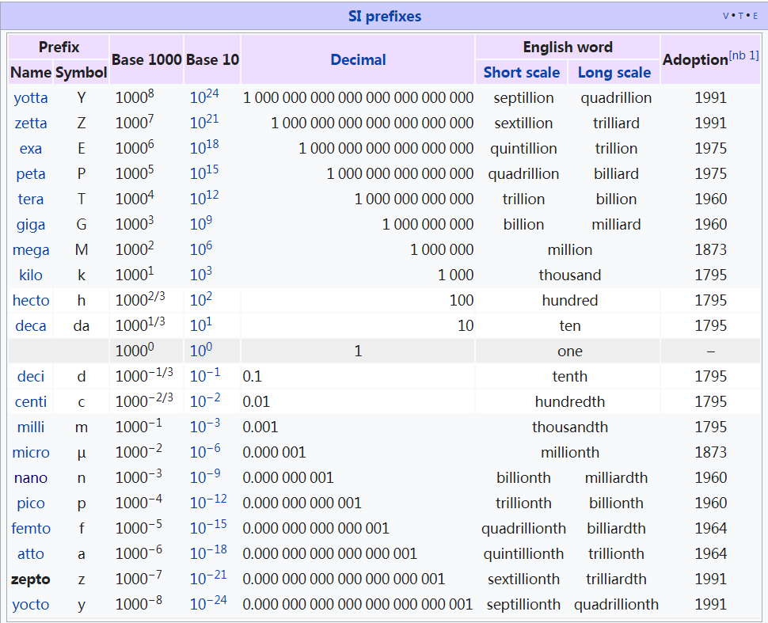

Slide 7
1. “Dialup” with a telephone modem:
Propagation delay = 5 ms, R = 56 kbps, M = 1250 bytes
L = 5 ms + (1250 x 8) / (56 x 10³) sec = 184 ms
2. Broadband cross-country link:
Propagation delay = 50 ms, R = 10 Mbps, M = 1250 bytes
L = 50 ms + (1250 x 8) / (10 x 10⁶) sec = 51 ms
A long link or a slow rate means high latency
– Often, one delay component dominates

Slide 8
Media have different properties, hence different performance
Reality check
Storage media »
Wires:
Twisted pairs »
Coaxial cable »
Power lines »
Fiber cables »

Slide 9
Send data on tape / disk / DVD for a high bandwidth link
Mail one box with 1000 800GB tapes (6400 Tbit)
Takes one day to send (86,400 secs)
Data rate is 70 Gbps.
Data rate is faster than long-distance networks!
But, the message delay is very poor

Slide 10
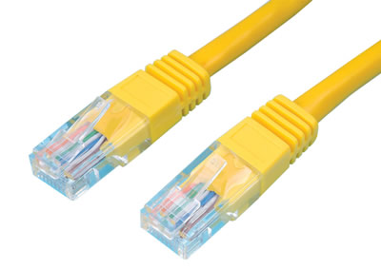
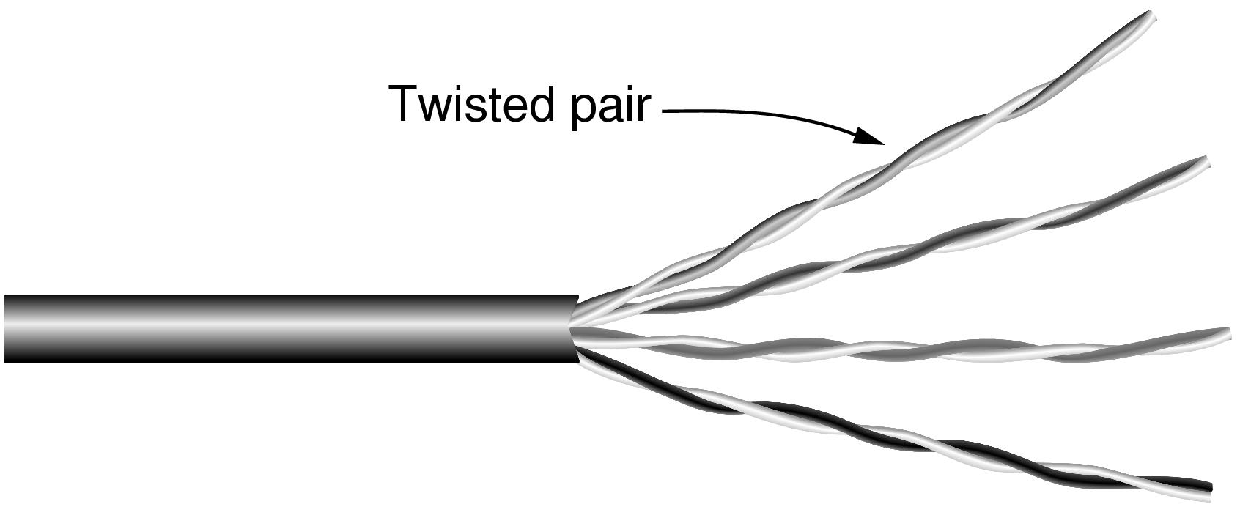
Wires – Twisted Pair
Very common; used in LANs, telephone lines
Twists reduce radiated signal (interference)
Category 5 UTP cable with four twisted pairs

Slide 11

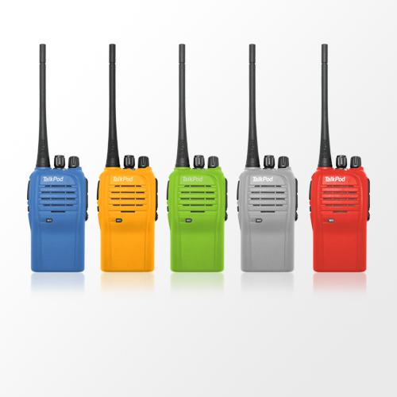
Wires – Twisted Pair
Full-duplex link
Used for transmission in both directions at once
e.g., use different twisted pairs for each direction
Half-duplex link
Both directions, but not at the same time
e.g., senders take turns on a wireless channel
Simplex link
Only one fixed direction at all times; not common

Slide 12
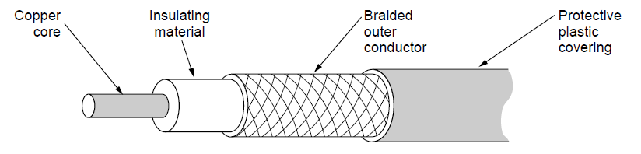
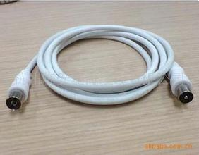
Wires-Coaxial Cable
Also common. Better shielding and more bandwidth for longer distances and higher rates than twisted pair.

Slide 13
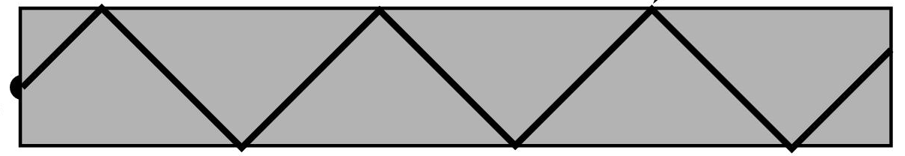


Fiber
Common for high rates and long distances
Long distance ISP links, Fiber-to-the-Home
Light carried in very long, thin strand of glass
Light source
(LED, laser)
Light trapped by
total internal reflection
Photodetector

Slide 14
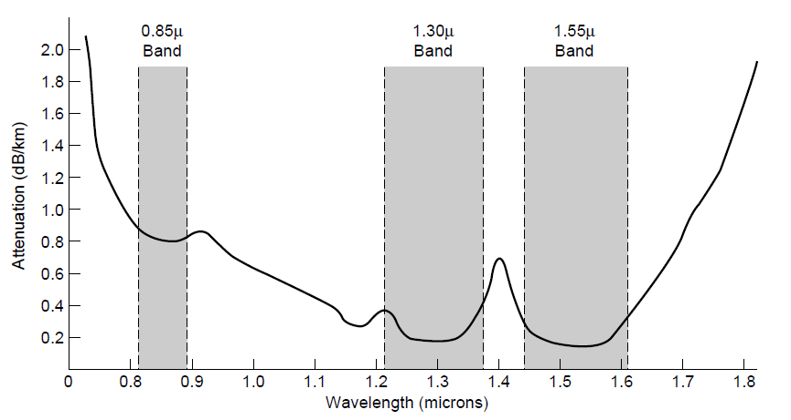
Fiber
Fiber has enormous bandwidth (THz) and tiny signal loss
– hence high rates over long distances

Slide 15
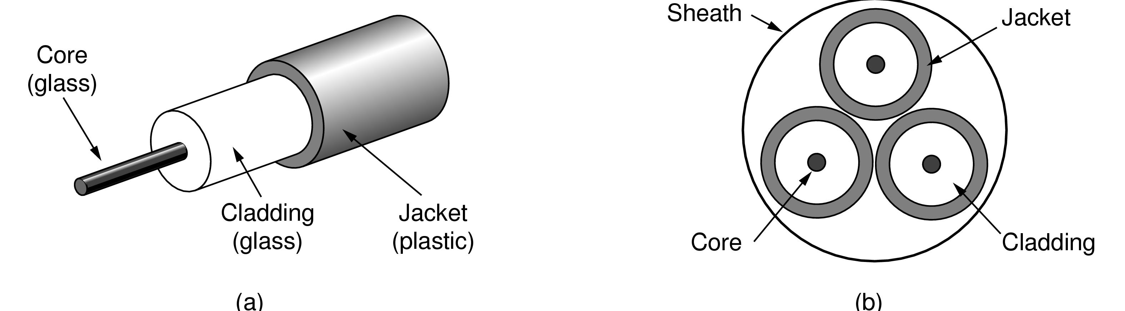
Fiber
Single-mode
Core so narrow (10um) light can’t even bounce around
Used with lasers for long distances, e.g., 100km
Multi-mode
Other main type of fiber
Light can bounce (50um core)
Used with LEDs for cheaper, shorter distance links
Fibers in a cable

Slide 16
Comparison of the properties of wires and fiber:
Property | Wires | Fiber
Distance | Short (100s of m) | Long (tens of km)
Bandwidth | Moderate | Very High
Cost | Inexpensive | Less cheap
Convenience | Easy to use | Less easy
Security | Easy to tap | Hard to tap
What happens to a signal as it passes over a wire?
1. The signal is delayed (propagates at ⅔c)
2. The signal is attenuated (goes for m to km)
3. Frequencies above a cutoff are highly attenuated
4. Noise is added to the signal (later, causes errors)

Slide 17
Wireless
Electromagnetic Spectrum »
Radio Transmission »
Microwave Transmission »
Light Transmission »
Wireless vs. Wires/Fiber »

Slide 18
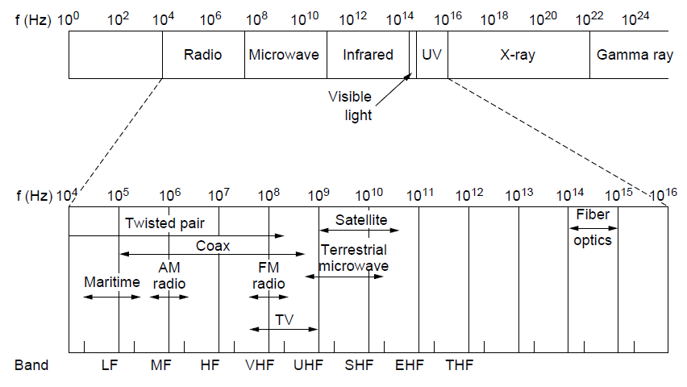
Different bands have different uses:
Radio: wide-area broadcast; Infrared/Light: line-of-sight
Microwave: LANs and 3G/4G/5G;
Networking focus
Microwave

Slide 19
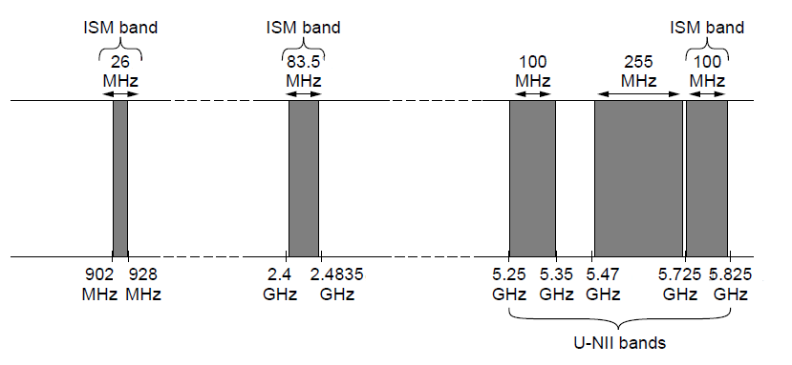
Fortunately, there are also unlicensed (“ISM”) bands:
Free for use at low power; devices manage interference
Widely used for networking; WiFi, Bluetooth, Zigbee, etc.
802.11
b/g/n
802.11a/g/n

Slide 20
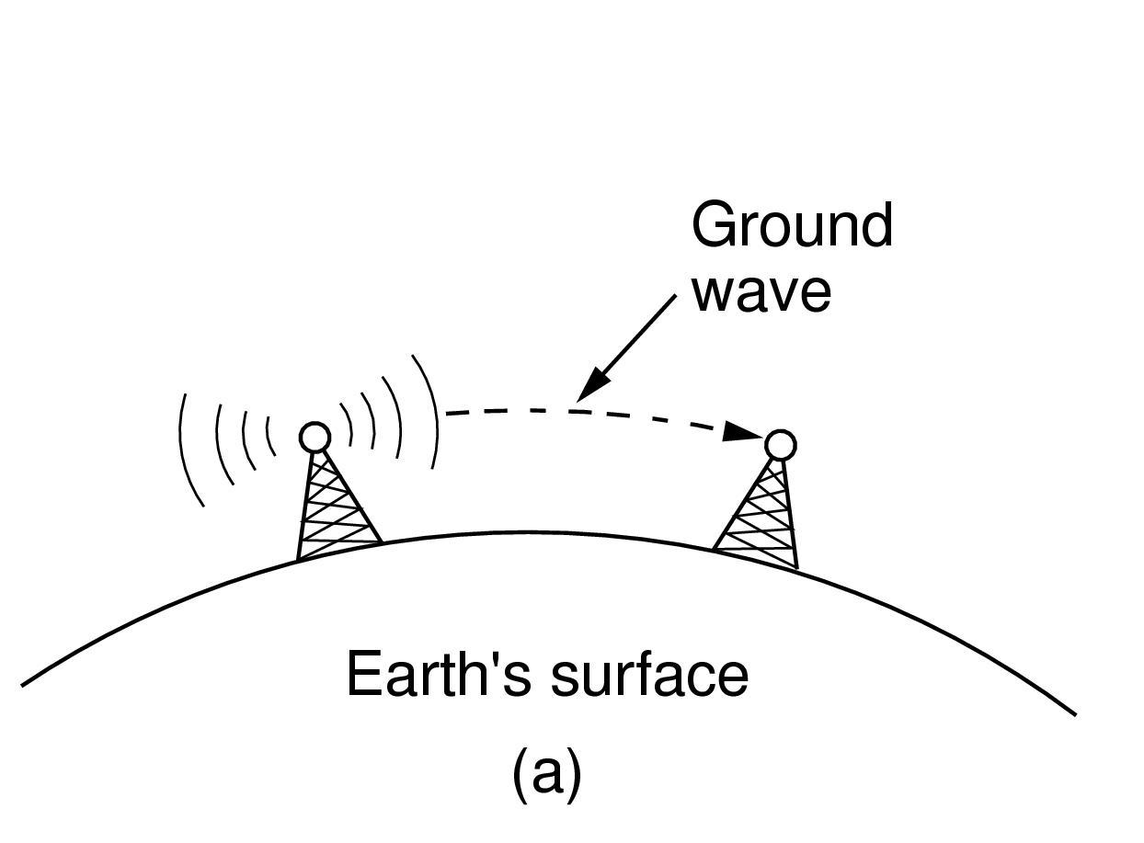
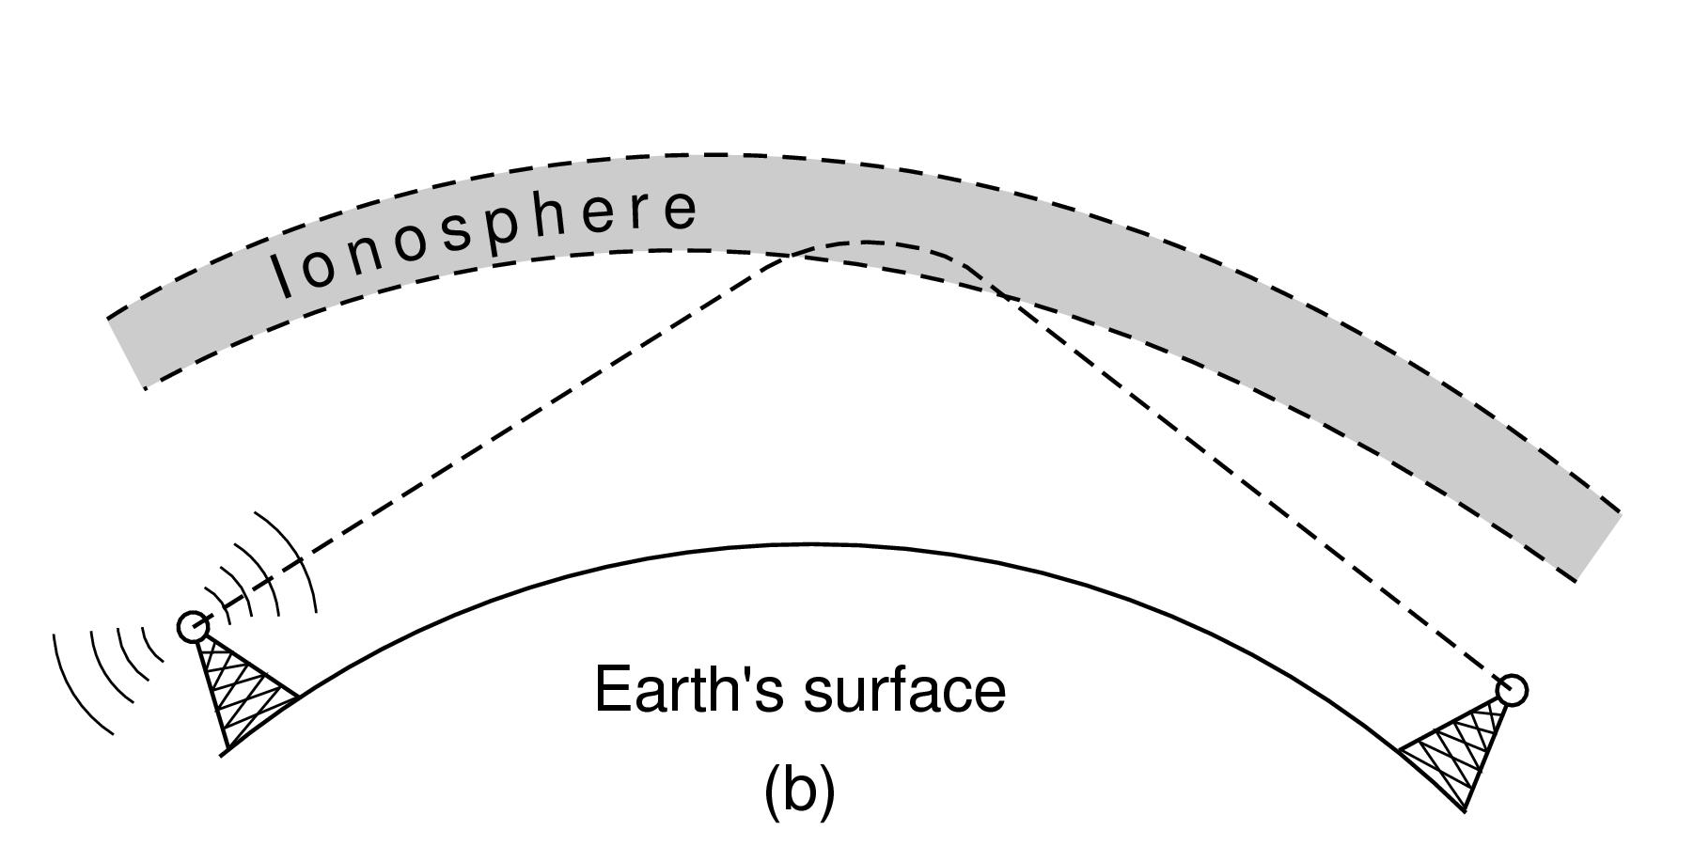
Radio signals penetrate buildings well and propagate for long distances with path loss
In the VLF, LF, and MF bands, radio waves follow the curvature of the earth
In the HF band, radio waves bounce off the ionosphere.

Slide 21
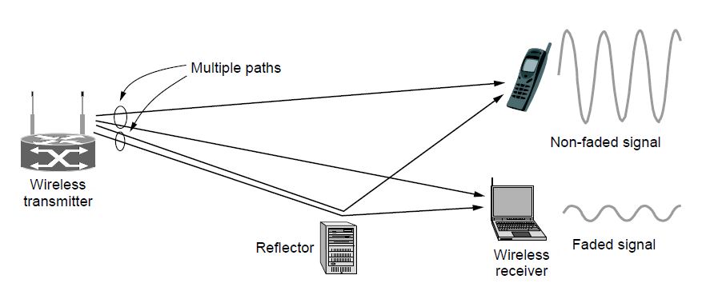
Microwaves have much bandwidth and are widely used indoors (WiFi) and outdoors (4G, satellites)
Signal is attenuated/reflected by everyday objects
Strength varies with mobility due multipath fading, etc.

Slide 22

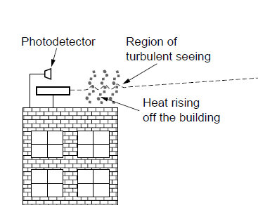
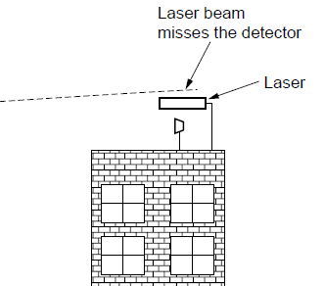
Line-of-sight light (no fiber) can be used for links
Light is highly directional, has much bandwidth
Use of LEDs/cameras and lasers/photodetectors

Slide 23
Wireless:
Easy and inexpensive to deploy
Naturally supports mobility
Naturally supports broadcast
Transmissions interfere and must be managed
Signal strengths hence data rates vary greatly
Wires/Fiber:
Easy to engineer a fixed data rate over point-to-point links
Can be expensive to deploy, esp. over distances
Doesn’t readily support mobility or broadcast

